Slide 1


INTERSTELLAR
INSIGHTS
Show Us What the May 2024 Geomagnetic Storms Looked Like

Slide 2
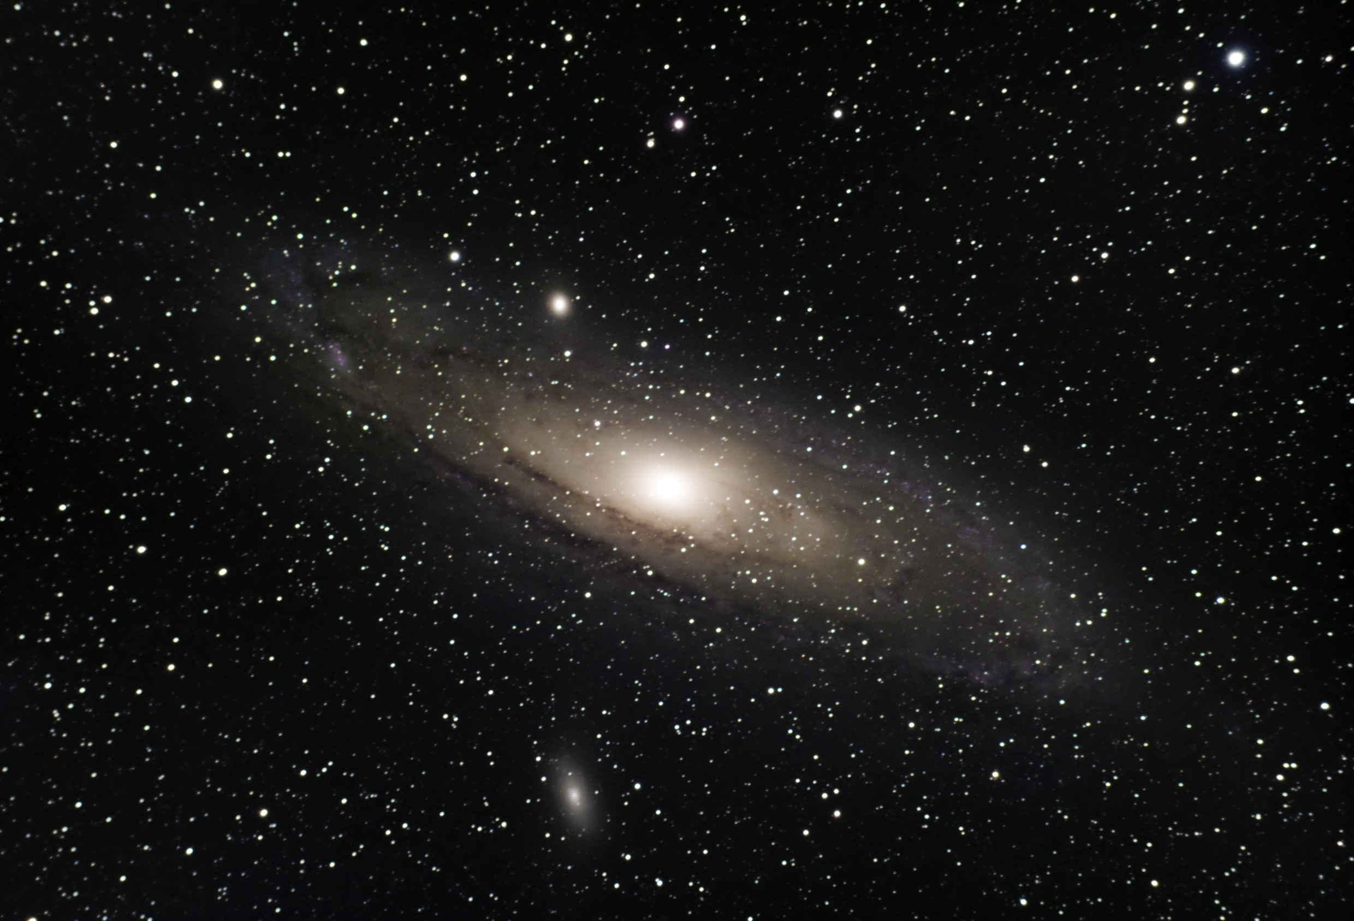
OUR PLAN
We created a chatbot, a video, and a game to convey the concept of solar storms more effectively. The chatbot provides instant answers to questions, while the video visually illustrates the impacts and science behind solar storms. The game engages users in an interactive way, allowing them to test their knowledge through fun quizzes.
Additionally, we developed comprehensive documentation that explains the topic in detail, covering the causes, effects, and safety measures related to solar storms. This multi-faceted approach ensures that users can learn and understand the subject from different perspectives, making the information more accessible and engaging.has context menu

Slide 3

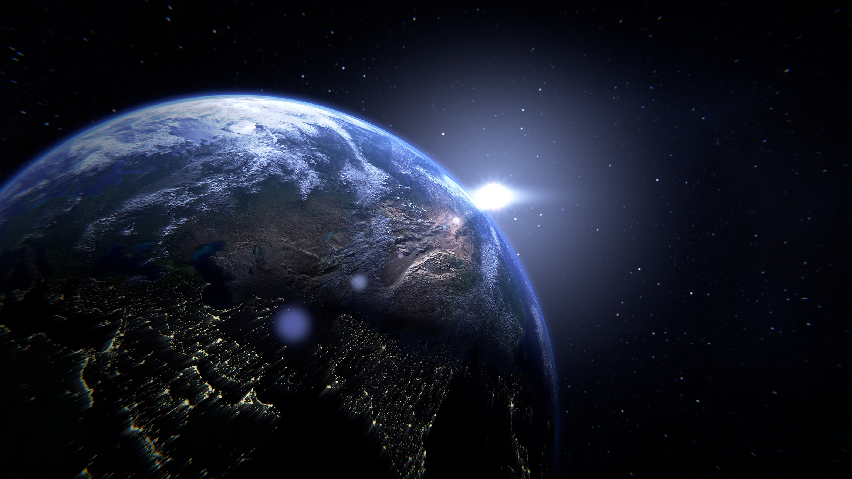
CHATBOT
A chatbot is an intelligent program designed to interact with users through text-based conversations. Its purpose is to answer any questions related to a specific topic, such as the effects of solar storms, by providing accurate and prompt information. and deliver responses based on available data, making it easier to access information and enhance understanding of the subject.

Slide 4
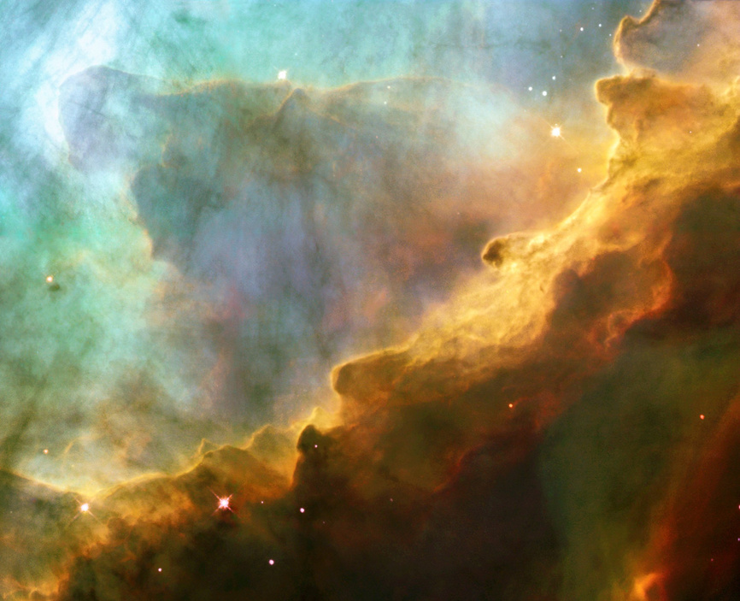
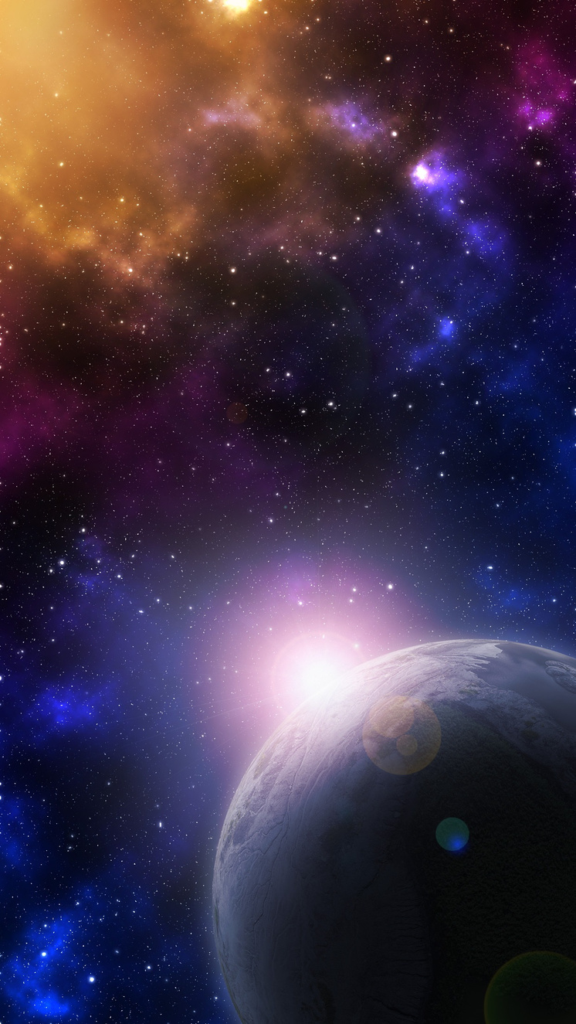
GAME
In this simple game, players answer multiple-choice questions about solar storms. Each question has options, and players must choose the correct answer to score points. The goal is to test knowledge about solar storms and their effects while having fun.

Slide 5

VIDEO
explores the Sun's significance and the phenomena of solar storms. It begins by explaining the Sun’s role as the primary energy source for Earth, highlighting how it sustains life and influences our climate.
Next, the video delves into solar storms, detailing their origins from solar flares and coronal mass ejections. It visually illustrates how these storms release massive amounts of energy and charged particles into space, potentially affecting Earth’s magnetic field.
The video emphasizes the impact of solar storms on technology, such as communication systems, power grids, and satellites. Through engaging graphics and real-world examples, it effectively conveys the importance of understanding solar activity and its implications for our daily lives.
Overall, the video serves as an educational tool, making complex concepts accessible and fostering a deeper appreciation for the Sun and its powerful effects on our planet.

Slide 6

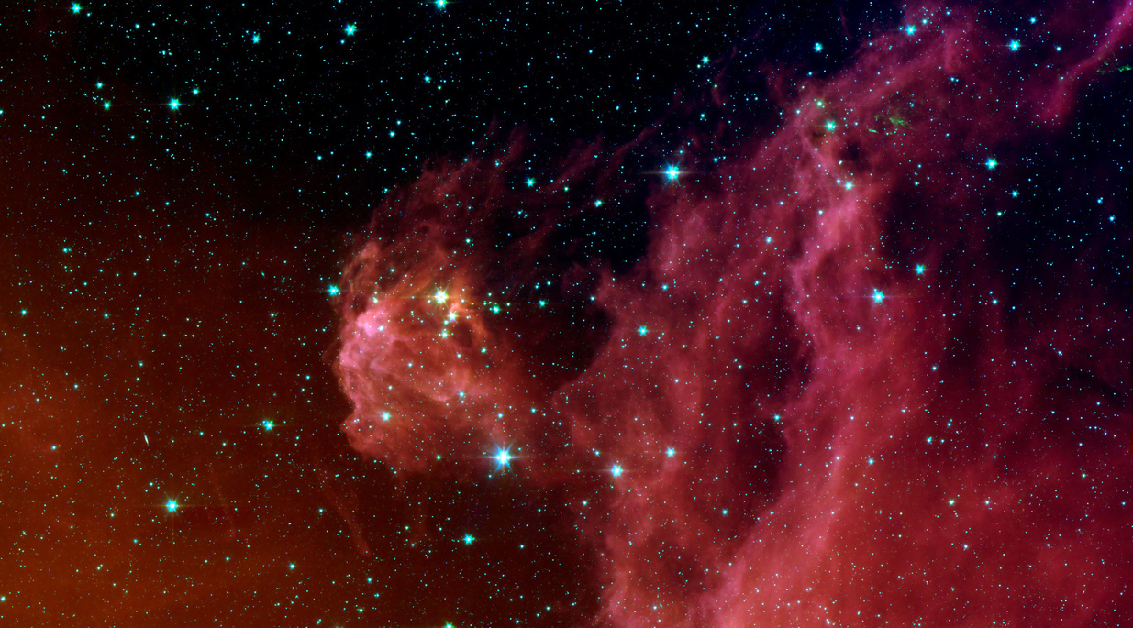
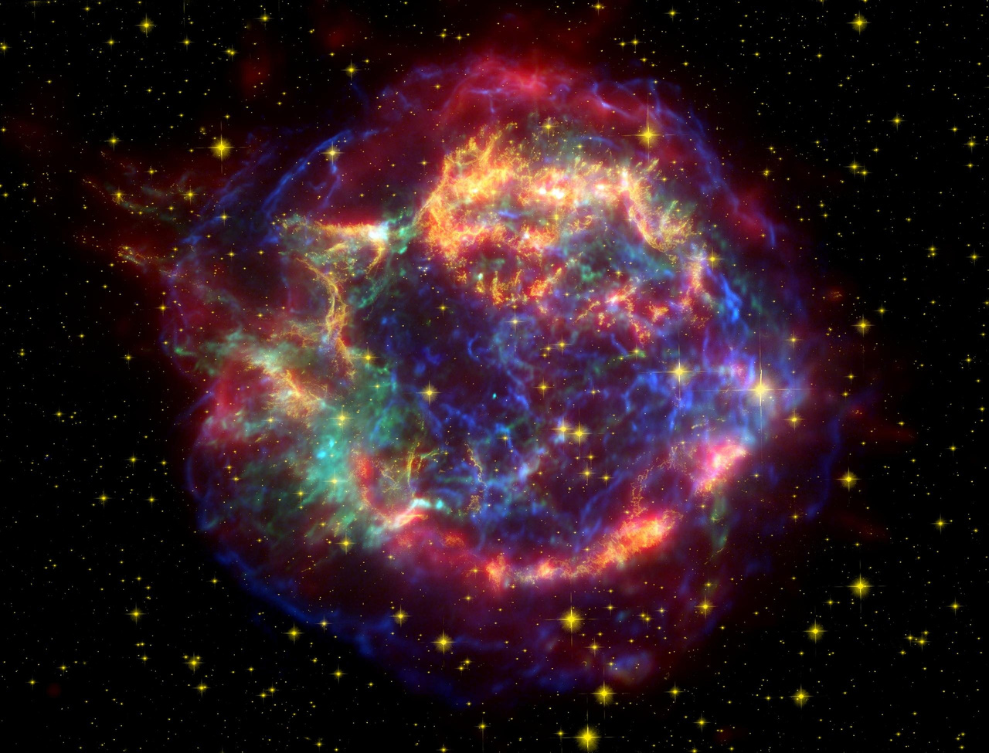
PREPARING FOR THE FUTURE
To mitigate the impacts of solar storms, enhancing prediction and monitoring capabilities is essential. Strengthening satellite design, reinforcing electrical grids, and establishing emergency protocols are crucial steps. Public awareness campaigns can educate communities on solar storm effects, while international cooperation and data sharing between agencies like NASA and NOAA are vital for addressing future risks.

Slide 7
THANK YOU !

